Slide 1
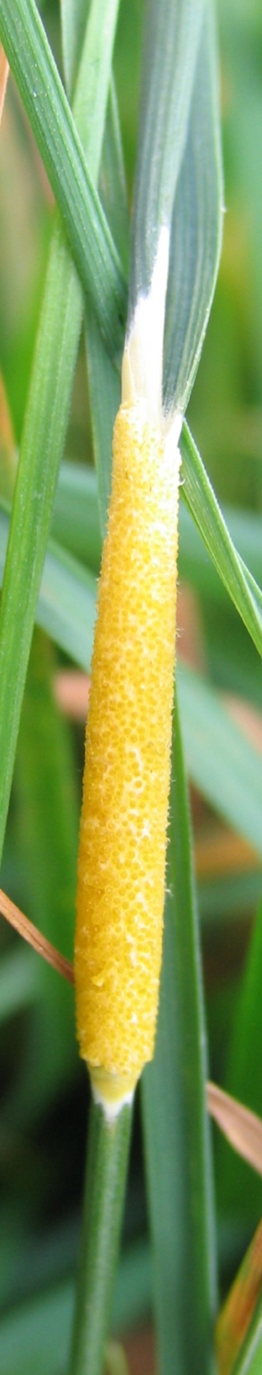

Statistical phylogenetic analysis for codivergence
Ruriko Yoshida
2010 PRE-SUMMIT KENTUCKY BIOINFORMATICS SESSION, UT-ORNL-KBRIN Bioinformatics
March 19, 2010

Slide 2
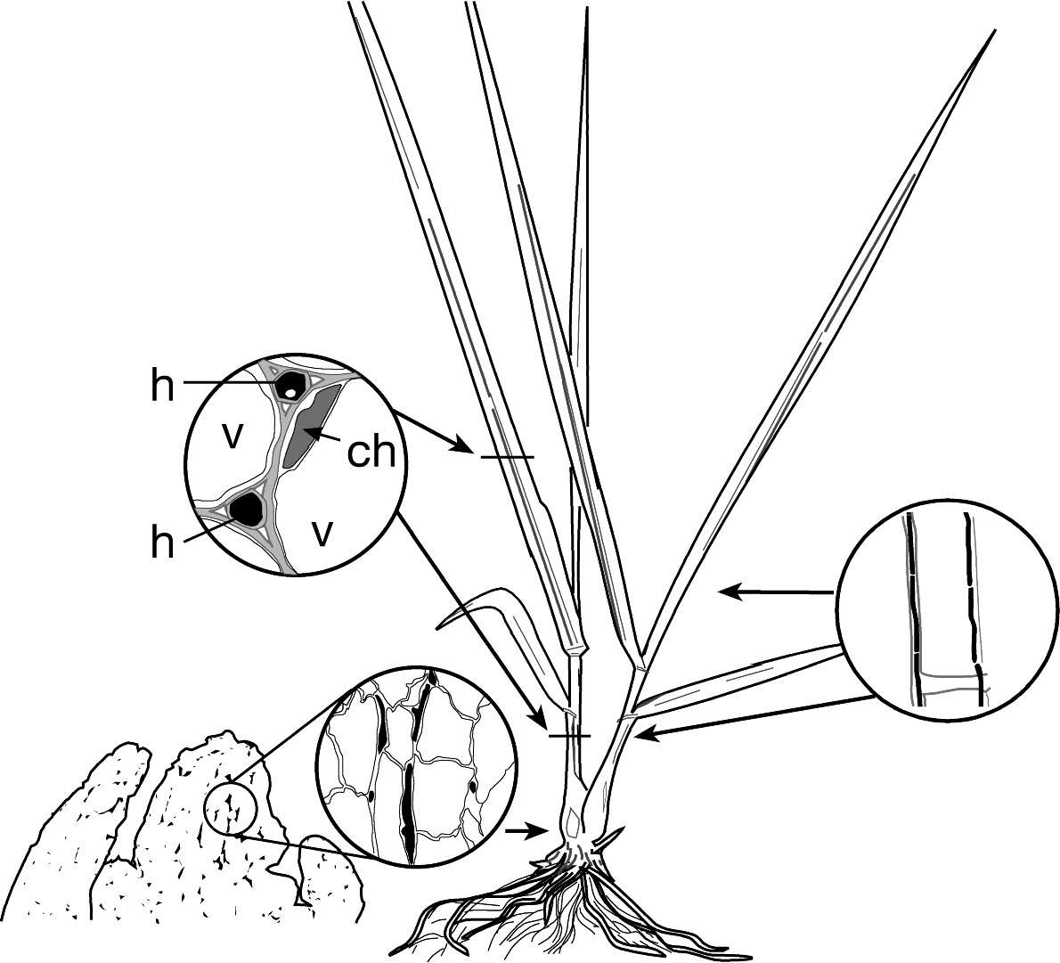
Epichloë/Neotyphodium in a grass plant
Symbioses are:
  Systemic
  Constitutive
  Often heritable
Symbiotic continuum:
  Mutualistic
  Pleiotropic
  Antagonistic

Slide 3
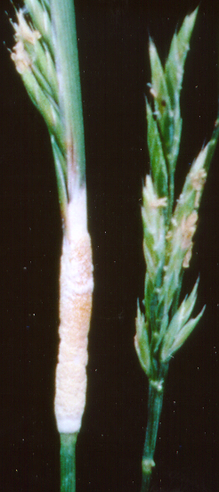

Life cycles of Epichloë and Neotyphodium spp.
asexual cycle & vertical transmission
sexual cycle & horizontal transmission

Slide 4
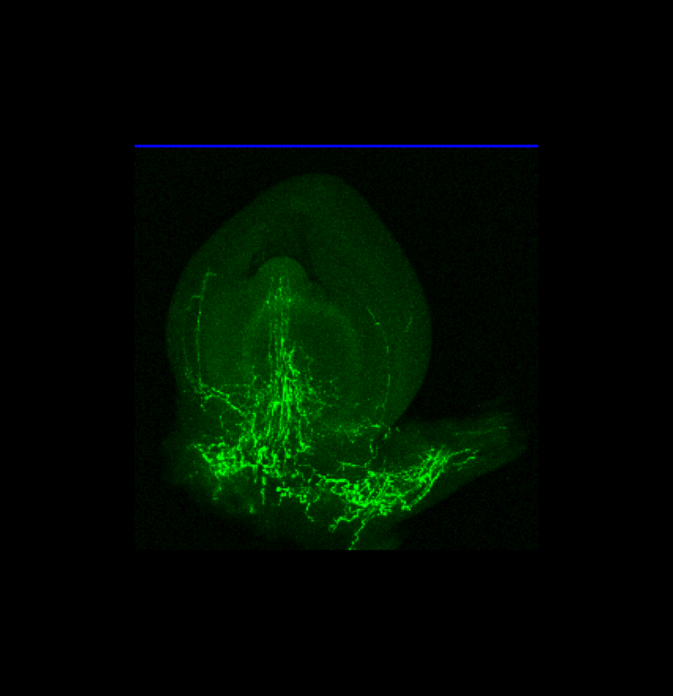
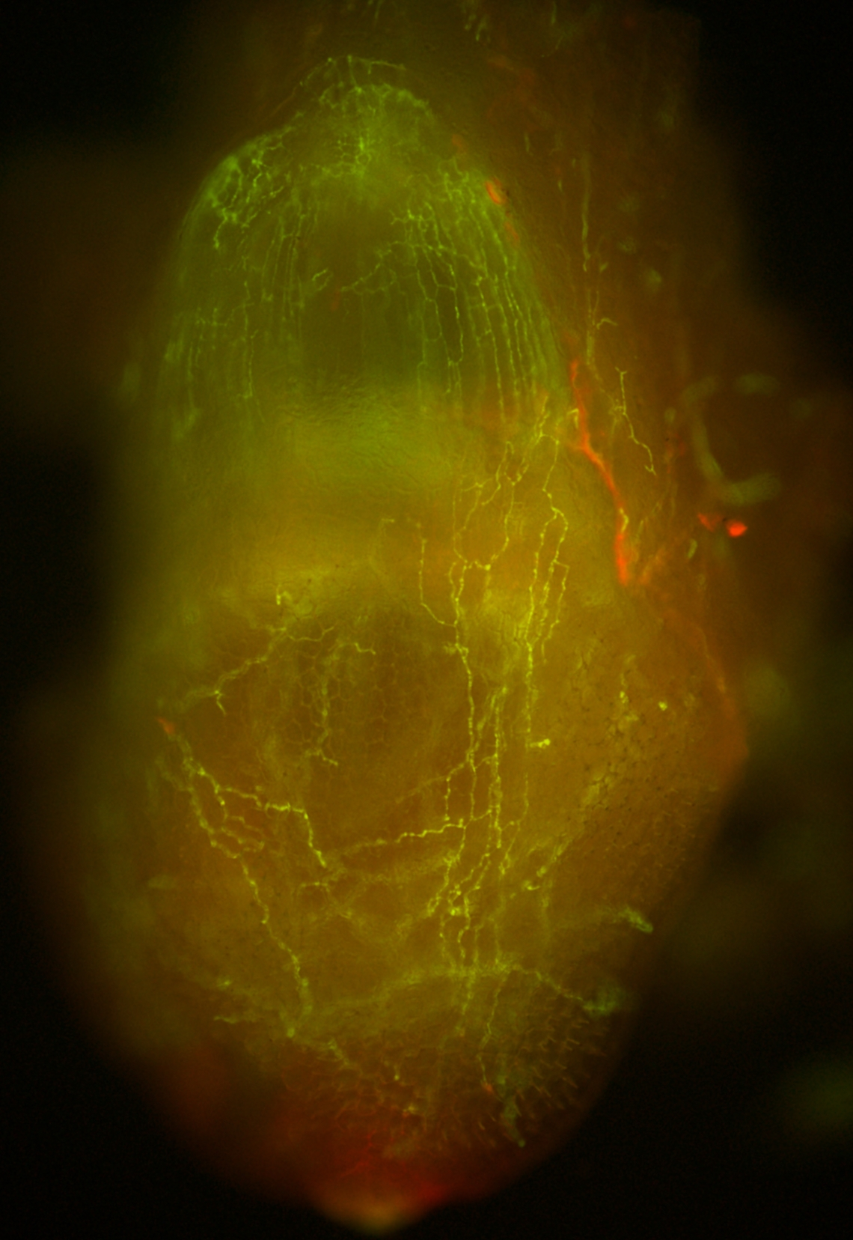
Vertical transmissibility
Lolium pratense shoot and meristem with
Epichloë festucae (w/GFP)
Confocal micrograph by Dr. Koya Sugawara
Lolium perenne embryo with
Epichloë festucae (w/GFP)
Christensen et al. 2008

Slide 5
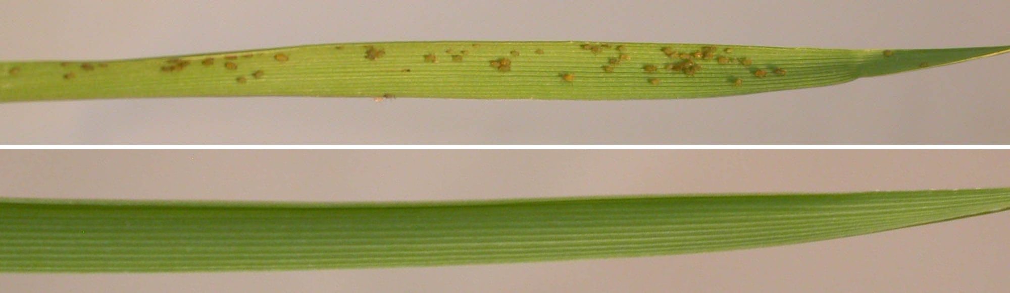
Endophytes protect against insects, nematodes, etc.
E–
E+

Slide 6

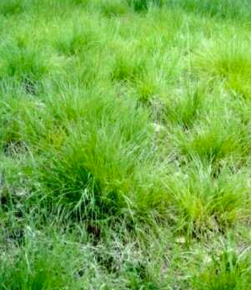

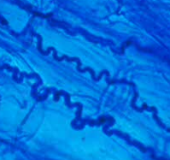

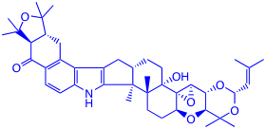
Mutualistic exchanges between grasses and endophytes
anti-insect
anti-vertebrate
anti-nematode
drought tolerance
etc.
nutrition
shelter
dispersal

Slide 7
Biological questions
Can we elucidate patterns of host and symbiont/parasite codivergence?
What happens (phylogenetically) during invasion of new niches?
How do sex and asexsual affect evolution?
Do neofunctionalized genes have unusual evolution ?

Slide 8
Biological questions
Can we elucidate patterns of host and symbiont/parasite codivergence?
What happens (phylogenetically) during invasion of new niches?
How do sex and asexsual affect evolution?
Do neofunctionalized genes have unusual evolution ?

Slide 9
Hypothesis:
H0: Pooideae and epichloae have NOT codiverged
H1:Pooideae and epichloae have codiverged.
Schardl CL, Craven KD, Speakman S, Stromberg A, Lindstrom A, Yoshida R. 2008. Systematic Biology 57: 483-498.

Slide 10
Hosts of Epichloë spp.
Epichloë sp. (MP)
Host tribe
Hosts
E. amarillans (IV)
Aveneae
Agrostis spp., Sphenopholis spp.
E. baconii (V)
Aveneae
Agrostis spp., Calamagrostis spp.
Epichloë sp.
Aveneae
Holcus mollis
E. brachyelytri (IX)
Brachyelytreae
Brachyelytrum erectum
Epichloë sp.
Stipeae
Achnatherum sibiricum
E. bromicola (VI)
Bromeae
Bromus spp.
Epichloë yangzii (VI)
Triticeae
Roegneria kamoji
E. elymi (III)
Triticeae
Elymus spp.
E. festucae (II)
Poeae, Aveneae
Festuca spp., Lolium spp., Koeleria sp.
E. glyceriae (VIII)
Meliceae
Glyceria striata
E. clarkii (I)
Poeae
Holcus lanatus
E. sylvatica (VII)
Brachypodieae
Brachypodium sylvaticum
Aveneae
Brachypodieae
Poeae
Phleum pratense, Anthoxanthum odoratum
Brachypodium spp.
Poa nemoralis, Poa trivialis, Dactylis glomerata, Puccinellia distans, Lolium perenne
E. typhina (I)

Slide 11
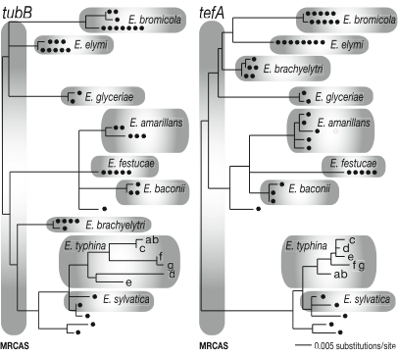
Epichloë gene trees

Slide 12
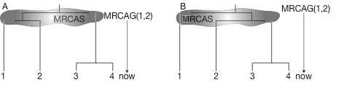
Lineage sorting effects and the species cloud

Slide 13
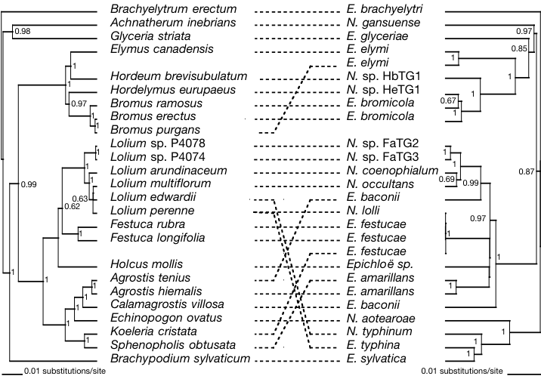
Host and epichloë phylogenies
Host cpDNA
Fungus tubB + tefA

Slide 14
Problem with pairwise distance approach
Distances
 | a | b | c | d
a | 0 | 2 | 6 | 6
b |  | 0 | 6 | 6
c |  |  | 0 | 3
d |  |  |  | 0
g
t = 3
f
e
a
b
c
d
phylogenetic tree

Slide 15
Pairwise distances to compare divergence times
G
g
(G,g)
f
E
F
e
pw distance (Endophyte)
(F,f)
A
B
C
D
a
b
c
d
(E,e)
Host tree
Endophyte tree
MRCA pair
Pairs of H and E taxon pairs
pw distance (Host)
(E,e)
((A,B),(a,b))
(F,f)
((C,D),(c,d))
(G,g)
((A,C),(a,c)), ((A,D),(a,d)), ((B,C),(b,c)), ((B,D),(b,d))

Slide 16
MRCALink: Sample each pair of nodes once if ‘valid,’ otherwise not.
G
g
(G,g)
f
E
F
e
Node age (Endophyte)
(F,f)
A
B
C
D
a
b
c
d
(E,e)
Host tree
Endophyte tree
MRCA pair
Pairs of H and E taxon pairs
Node age (Host)
(E,e)
((A,B),(a,b))
(F,f)
((C,D),(c,d))
(G,g)
((A,C),(a,c)), ((A,D),(a,d)), ((B,C),(b,c)), ((B,D),(b,d))

Slide 17
MRCALink on incongruent trees
G
g
f
(F,g)
(G,g)
E
F
e
Node age (Endo)
(G,f)
A
B
C
D
a
b
c
d
(E,e)
Host tree
Endophyte tree
MRCA pair
Pairs of H and E taxon pairs
Node age (Host)
(E,e)
((A,B),(a,b))
(G,f)
((A,C),(a,c)), ((B,C),(b,c))
(G,g)
((A,D),(a,d)), ((B,D),(b,d))
(F,g)
((C,D),(c,d))

Slide 18
Apply MRCALink to Pooideae-epichloae

Slide 19
Bivariate plots: Full and trimmed
Full
p = 0.123
p < 0.001

Slide 20
Codivergence of epichloae and Pooideae.
Suggests ancestral symbiosis 30–40 Mya.

Slide 21
Working on identifying likely host jumps

Slide 22
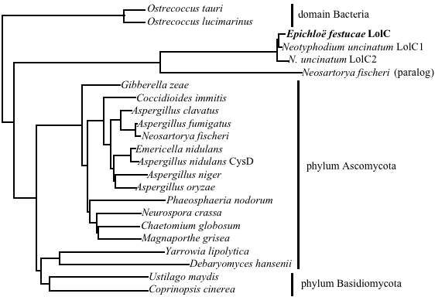
cysD and lolC relationships
Why?
  Paralogs with many losses?
  Long-branch attraction?
  Horizontal transfer?

Slide 23
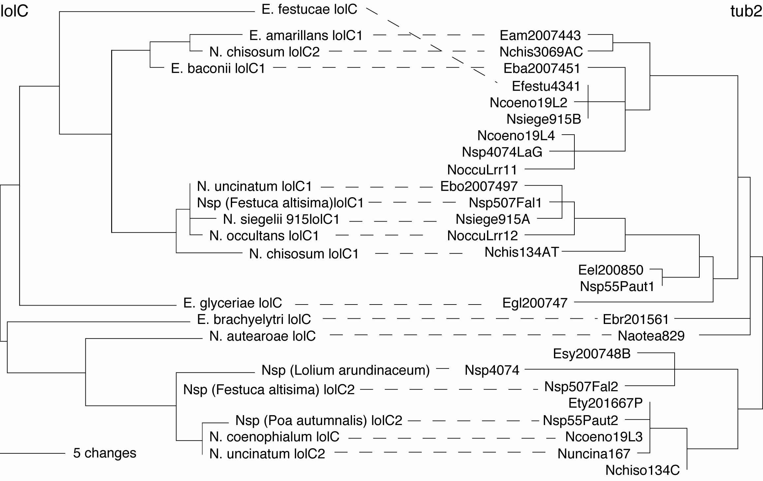
lolC vs. tub2 phylogeny

Slide 24


Acknowledgments
Collaborators:
  Jerzy W. Jaromczyk (UK)
  - Chris Schardl (UK)
  David Haws (UK)
  David Weisrock (UK)
  Eric O’Niell (UK)
  Peter Huggins (Fall 2010, UK)
  Arny Stromberg (UK)
NIGMS
NSF

